Slide 1
Assumptions for Confidence Interval

Slide 2
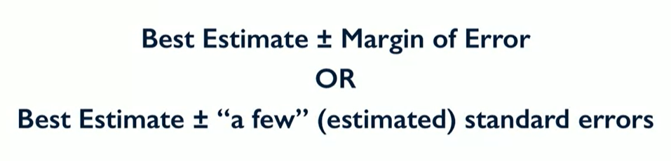
Confidence Interval

Slide 3
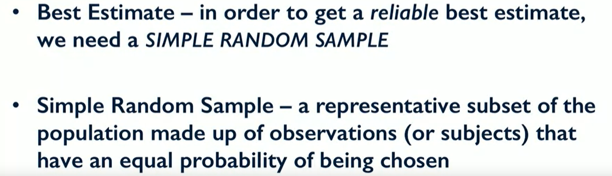
What are the Assumptions?

Slide 4
What are the Assumptions?
Population sample should be normally distributed.
Larger Sample Size → Better approximation
With confidence interval of a population proportion we need at least 10 responses of each outcome(e.g. Yes\No)

Slide 5
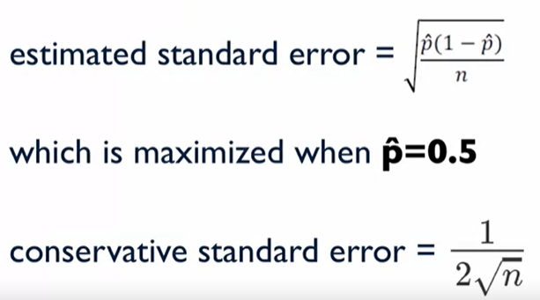
Estimated Standard error Vs Conservative Standard error
When the p^ is not accurate because of poor random sampling then we maximized our standard error by Conservative approach.
When p^ = 0.5

Slide 6
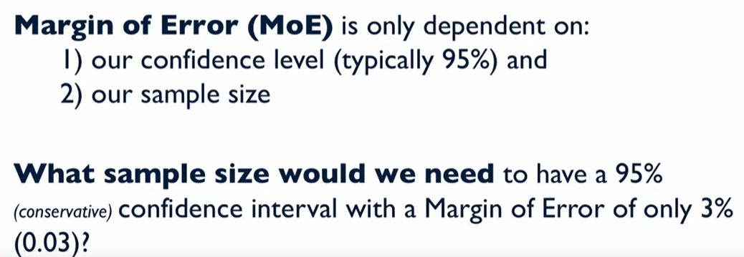
Sample Size Determination

Slide 7
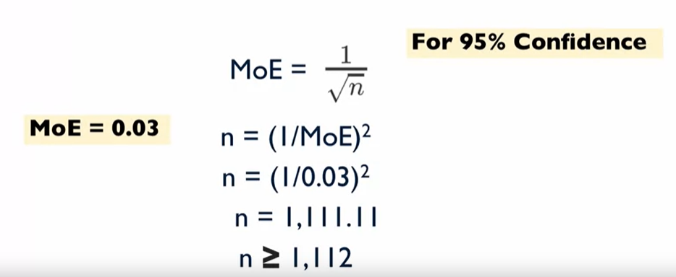
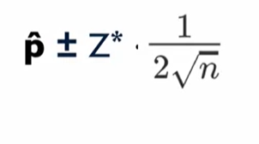
Sample Size Determination

Slide 8

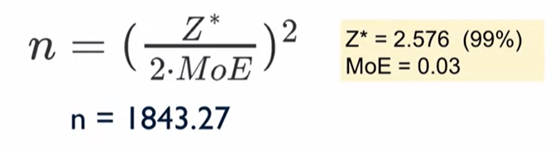
What if MOE 3% with 99% confidence?

